Slide 1

Meteorite Landings
By: Armand, Carlos, and Gerald

Slide 2
Objectives
Plot meteorite landings of the dataset
Analyze where the landings are according to our data set

Slide 3
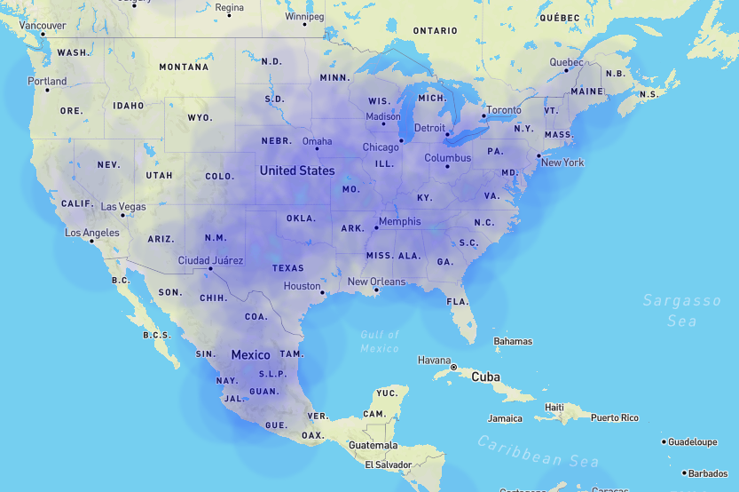
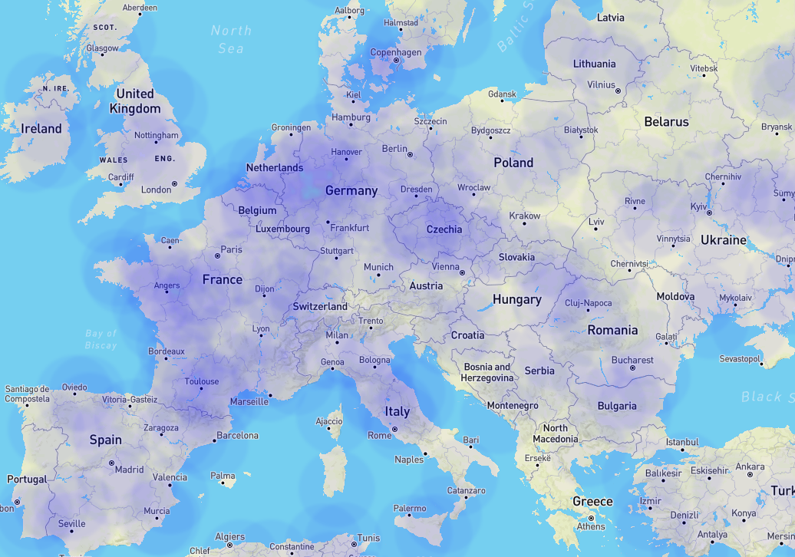
Heat Map Comparisons
North America
Europe

Slide 4
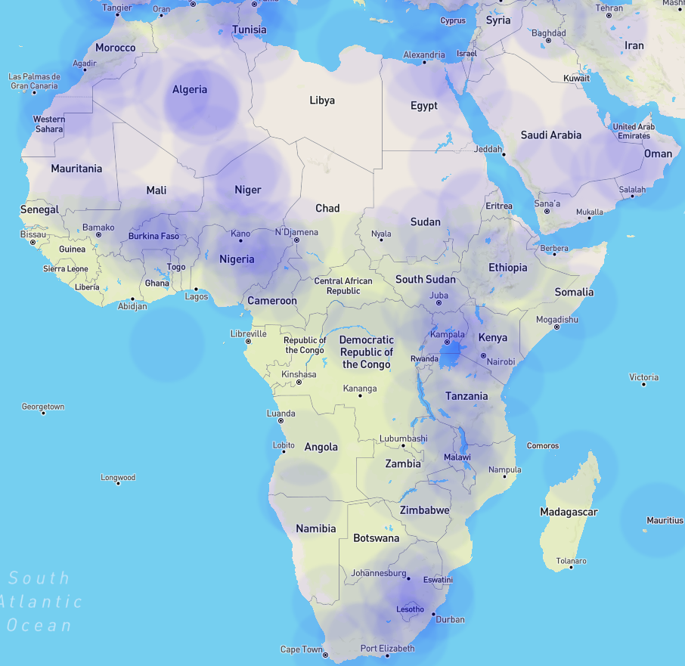
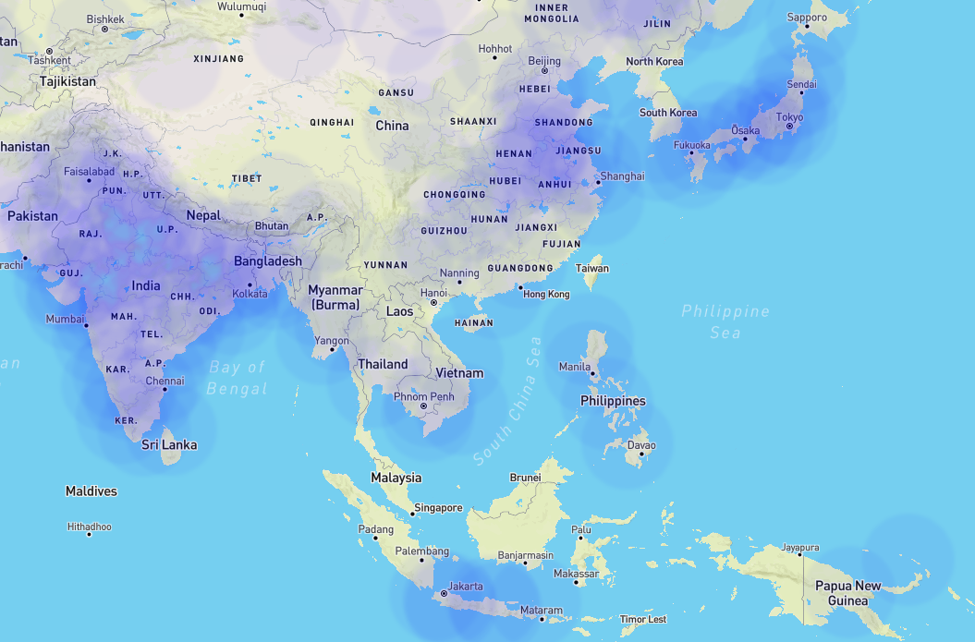
Heat Map Comparisons Cont..
Africa
Asia

Slide 5
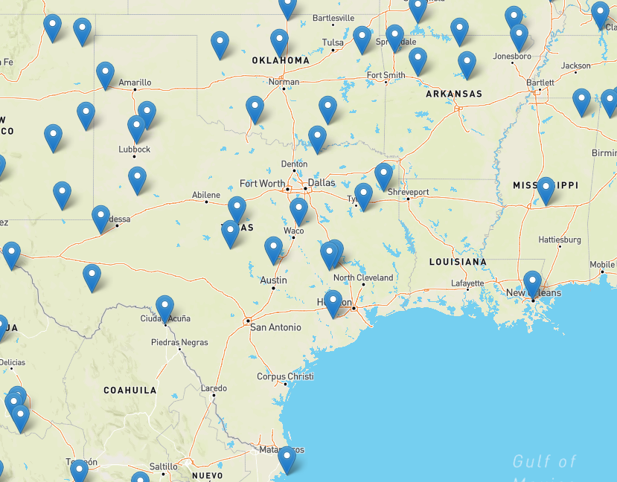
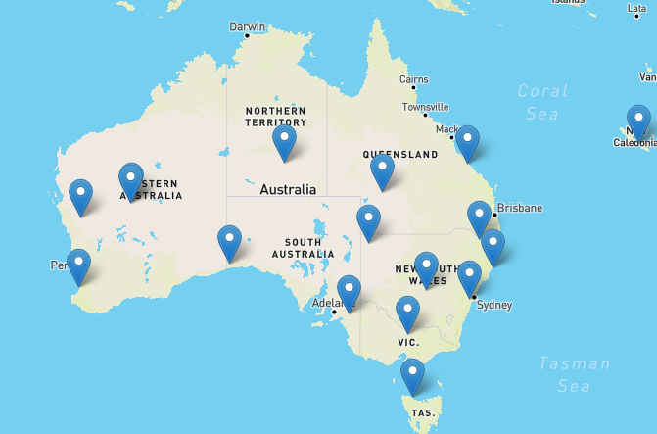
Leaflet Marker Comparison
Australia
United States (Texas, Louisiana, Oklahoma, Arkansas, Mississippi)

Slide 6
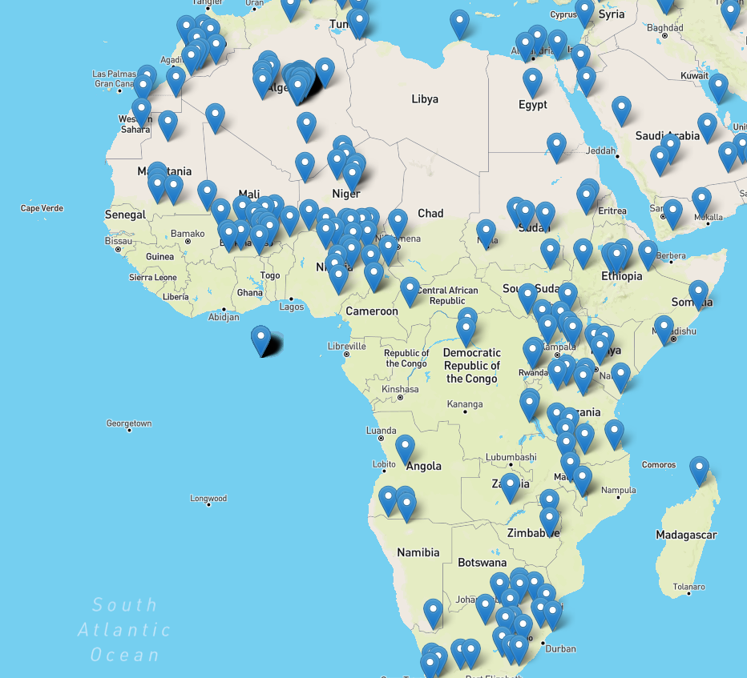
Leaflet Marker Comparison Cont..
Africa

